Slide 1

FLL Mentor Training Grades 4-5
Outline
G. Deane
v.2015-09-10

Slide 2
Syllabus
Getting Started
Preparing to Launch
The First Meetings
Getting Going on the Robot Game
Robot Programming
Completing Your First Robot Missions
The Project
Advanced Concepts: Navigation and Sensors
Advanced Concepts: Robot Design and Repeatability
Advanced Concepts: Other Elements
Revisiting Core Values
Preparing for the Competition
Competition Day
Wrapping Up the Season

Slide 3
Session 1
Getting Started

Slide 4
Getting Started Deciding to be a Mentor
Reasonable amount of work, but incredibly fun
Expect 4-6 hrs / week of time, ramping to 6-8 hrs/week just before the competitions
Season goes from early September through December (or January)
Teams of 4-6 kids (can go as high as 10, but not recommended)
Hands on way to invest in kids, teaching
Teamwork and organization
Structured thinking
Trial and error
Presentation and speaking

Slide 5
Getting Started Sign Up Sheet
Please sign in
Name
Email
phone number
Mentored before?
Do you have a team assembled and full?
Do you need to build a game table and would you like me to buy parts for you (cost is $125, including sawhorses) to build at Saturday’s workshop?

Slide 6
Getting Started The Role of a Mentor
Adult mentors coordinate and lead teams of kids
Lead meetings
Shepherd team of kids
Administrate the team (schedules, equipment, finances, space, etc)
Mentors can help the kids, but the KIDS DO THE WORK
If you don’t know how to do something, look it up TOGETHER!

Slide 7
Getting Started The FLL Season
Mentor training
“Coaching for Coaches”
each Thursday at 6pm
Planned initially at Cherry Crest
(may be some teleconferences if preferred)
Organize Teams
Register Teams with US FIRST
Scrimmage and Sharing at CC
FLL Game Released
Buy Mission Models
Team Meetings
Register for a Tournament
Qualifier Tournament
Regional Tournament
State Tournament
8/1 9/1 10/1 11/1 12/1 1/1 2/1

Slide 8

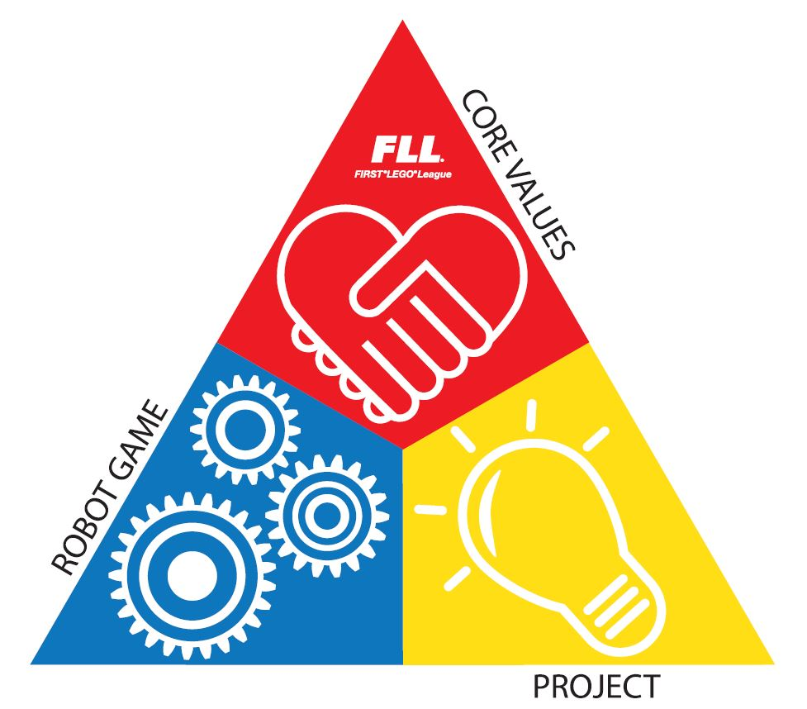
Getting Started What is FIRST Lego League?
Collaboration between FIRST and Lego
Open to kids from 4th-8th grades
Designed to be about the experience, not the competitions. Focus on:
Research Project
Practice of FLL Core Values
Engineering Design
Robot Performance
Competitions provide an endpoint, not the motivation.

Slide 9
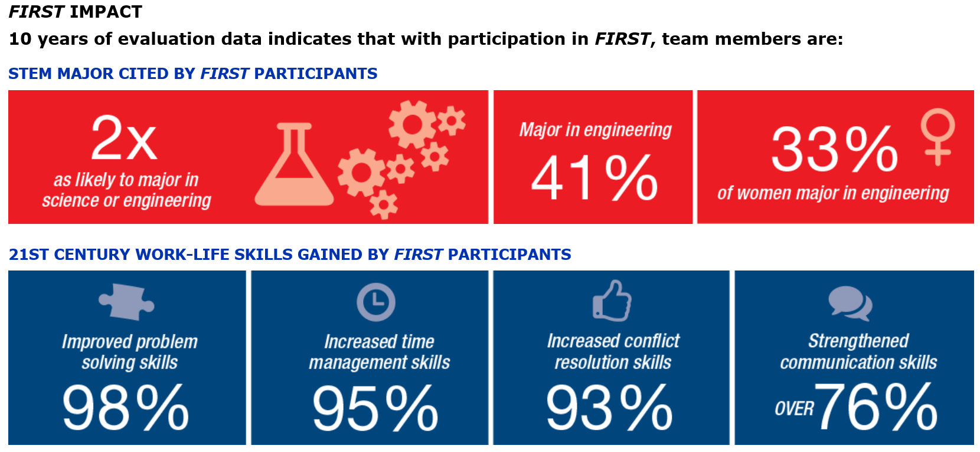
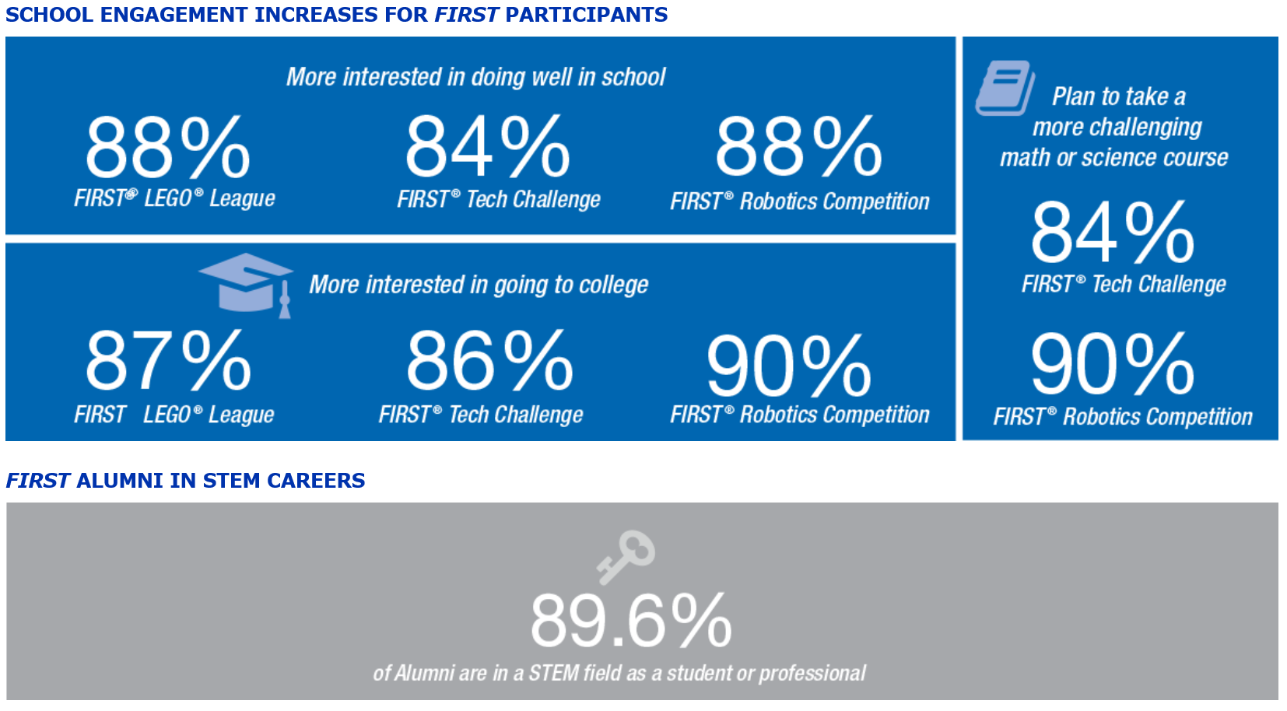
Getting Started Why we do this!

Slide 10
Getting Started FIRST and Washington FIRST Robotics (WFR)
Our mission is to inspire young people to be science and technology leaders, by engaging them in exciting mentor-based programs that build science, engineering and technology skills, that inspire innovation, and that foster well-rounded life capabilities including self-confidence, communication, and leadership.
FIRST = For Inspiration and Recognition of Science and Technology
“Robotics” is nowhere in there
Building a robot provides a means for learning, but it is NOT the objective
US FIRST (www.usfirst.org) is the central organization
Founded by Dean Kamen and Woody Flowers
Located in New Hampshire
Main function is central coordination, game design, and overall program
Washington FIRST supports and executes the program in the state

Slide 11
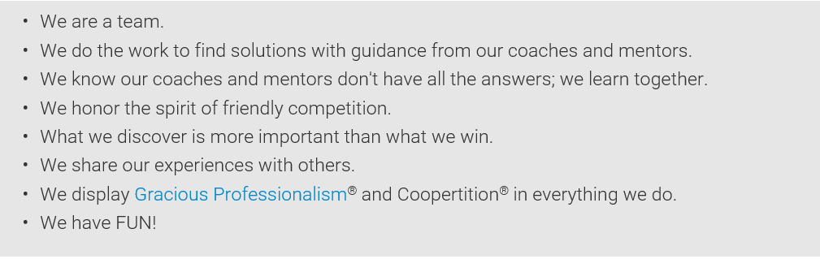
Getting Started Teaching FLL Core Values
http://www.firstlegoleague.org/mission/corevalues

Slide 12
Getting Started Organizing a Team
Teams tend to be 4-6 kids, but may be as many as 10
If more than 5, expect to need an assistant mentor
Must register an assistant anyway
Recommendation:
Organize a team via email / phone with parents
Establish meeting times
Establish a team mailing list

Slide 13
Getting Started Registering Your Team
Read about it here: http://www.firstlegoleague.org/challenge/startateam
Start here: https://my.usfirst.org/fll/tims/site.lasso
Create a user account by clicking the 3rd blue button on the right side of the page
Read and agree to the Terms and Conditions
Fill in the information to create a user account
Setting Up a New Team
Go back and Log In.
If you mentored last year and were listed as a mentor, your previous team can be selected
Otherwise, under “Teams I Can Administer”, click “Create a Team”
Select the radio button for “Main Contact”
You’ll need to pass the online background check (usually takes about a day)
Click the Edit/View buttons for Team Information and Team Contacts on the Team Summary page
After you have entered this information, follow the link below to pay the team fee of $300.
Make sure to add invitations to team members. Once parents have registered their kids, you have to go back in and allow them onto the team
Register for a Competition
From the Team Summary page, follow the link to register for a competition. Fee is $350. (this may not be open yet for WA – email will alert you)
Order Mission Models
From the Team Summary page, follow the link to “Order.” Buy the Mission Models Kit / Mat (~$75.00)

Slide 14
Getting Started Assistants / Establishing Roles of Other Parents
Decide early on how much help you would like from other parents.
Recommendation: Enlist help from 1 other parent who will come most of the time to work on either the robot challenge, or the research project

Slide 15
Getting Started Setting Up the Team Schedule
Establish a team calendar for meetings – 2 meetings/week, 90-120 min per meeting.
After a few meetings, once you understand the Challenge, pencil in some rough milestone goals for the team to make sure you’re moving along.
Schedule some additional meetings near the end of the competition to give the kids time to apply finishing touches and to not feel rushed
Consider scheduling several collaboration meetings with another team where you can share what you’re doing, and teach each other what you’ve learned (and make sure your team records what they learned, as the judges will be interested!)

Slide 16
Getting Started Coaching Multiple Teams
It’s very doable.
Space is an issue. You’ll need places where the teams can go so they’re not tripping over themselves.
Parent advisors is an issue. Consider emphasizing the assistant mentor positions for each team.

Slide 17
Getting Started Sharing Mentor Information
You will receive regular emails
Some from US FIRST – high level & programmatic. Pay attention to changes to the rules as they are refined during the season
Some from WA FIRST – much more operational usually, focusing on competition events
Some from Cherry Crest Robotics
Wonderful resources all over the web. I’ll try to share when I find.
Coach Resources: http://www.firstlegoleague.org/challenge/teamresources
FLL Coach’s Handbook: http://www.firstlegoleague.org/sites/default/files/Challenge/TRASH-TREK/FLL-CoachesHB'15-'16-TRASHTREK-Online.pdf
I will store mentor information in a DropBox.
I will send out the link once I get a list of mentors and emails.
Find information from WA FIRST here
http://www.firstwa.org/Programs/FIRSTLegoLeague/FLLDownloads.aspx

Slide 18
Session 2
Preparing to Launch

Slide 19
Preparing to Launch Meeting Space
Set up your meeting space so that groups of 2-3 kids can work in a focused way for an hour at a time without interruption.
Generally, designate an area for team meetings, for project work, and for the robot game work.
Note: The robot game requires space for a 4’x8’ table, with 2’ of space around the perimeter, space to set up a computer to program, and space to store lego parts.

Slide 20
Preparing to Launch Understanding the Schedule
Scheduling out where the team hopes to be by when is critical to managing the season.
Tip: Give this job to one of the kids to manage. Help them make a schedule, and ask them each meeting to assess how the progress is going

Slide 21
Preparing to Launch Managing Finances
This year, we are NOT running finances through Cherry Crest
Administratively, it was too much work and not necessary.
Expected Budget:
US FIRST Team Registration: $ 300
WA FIRST Event Registration: $ 350
Mission Models (from Lego): $ 75
Costumes, posters and supplies: $ 100
Game table: $ 125
Extra Lego pieces, as needed: $ 50
Total: $1,000
Cost / child: $200 (based on 5 kids)
TIP: While you need to be responsible for the team’s $$, you can ask a kid to help make and keep track of income and expenses

Slide 22
Preparing to Launch Using Booster Accounts
Booster accounts are set up and administered by WA FIRST, enabling your team to receive tax-deductible donations.
Read about how to set one up, the rules for using them, and why you want to do this: http://www.firstwa.org/Portals/0/FIRSTWA_Files/WFRBoosterInstructions.pdf
DO NOT FORGET to register your matching funds or hours with your employer.
Even if you do not use donated funds this season, they will be there next season to reduce future costs.

Slide 23
Preparing to Launch Setting Parent Expectations
Communicate to the parents by email at least once per week, letting them know what’s been happening, and what is coming up. It takes 10 minutes, and is really worth it.
It’s important to set parent expectations, early and often
This is NOT a “Robotics” program where everyone becomes a Mechanical Engineer, Controls Theoretician and Software Dev overnight.
The objective is to expose kids to scientific thinking in a fun and engaging way.
You can take a few sessions to show each kid a little of the programming, but in the end, you’ll probably have 1 or 2 kids working on the code and the robot. The others will work on other elements.

Slide 24
Preparing to Launch Ordering Lego Kits, Mission Models and Other Parts
The school is providing Lego kits to each team.
These kits have been through 2 seasons, and likely are missing some parts.
On Saturday 9/19 we’ll be at CC to host a kit sorting / table building party

Slide 25
Preparing to Launch Building the Playing Table
Playing table is a 4x8 sheet of ¾” plywood with a border of 2x4’s, seated atop a table or two sawhorses. One time cost ~$125.
Mission models and field mat are ordered through Lego for ~$75
They will take one person 6+ hours to build, so plan on using the first team meeting to build these. Let the kids build them, but do pay attention, as if they’re not built properly, the team could spend a lot of time trying to solve missions incorrectly!

Slide 26
Preparing to Launch Organizing the Meetings
You control the meetings.
Consider:
Start each meeting with a group discussion and outline the day’s plan (10min)
Break the team up to go execute the plan
Reconvene at the end of the meeting (15-20 min) so each kid can talk about what they did that day, and the team can share in the progress.
Other things to consider:
Make sure the kids aren’t hungry during the meetings
Make sure they take regular breaks during the meetings
Besides helping kids who are stuck, the mentor’s job is to scout to make sure all of the kids are actively involved.

Slide 27
Preparing to Launch Learning About the Challenge
READ the Challenge Document, and revisit the information EVERY WEEK as the rules change and are clarified constantly.
Good app on the phone that will ping you with updates
http://www.firstlegoleague.org/challenge/2015trashtrek
Videos are great, but they are SECOND to reading the documents!

Slide 28
Session 3
The First Meetings

Slide 29
The First Meetings Opening the Meeting
Start the meetings on time, even if some kids are late.
Ask the team what they hope to accomplish during that day.
You can make suggestions, or you can ask one of the kids to track progress against goals to see where the team needs to be.
Discuss the goals and make sure the kids have a chance to opine, especially on the work that other kids will be doing that day. They’re a TEAM and they work together, even when they have to divide and conquer.
Once you have the day’s goals set out, split them up! Remind them that they will report back on their progress at the end of the meeting.

Slide 30
The First Meetings Building Team Identity, Awareness & Enthusiasm
Early – pick a team name.
Ask the kids to come up with a team cheer, clap, handshake, special team fist bump, etc.
Decide how the team will operate – how will they resolve conflicts. Focus on building norms that center on the FIRST Core Values

Slide 31
The First Meeting Introducing the Challenge
Watch the FLL videos with the kids
Ask the kids to read the challenge aloud, and to ask questions as they go. Write down the questions, and see if the kids can answer them on their own.
Read the Challenge Updates.

Slide 32
The First Meetings Picking a Research Project
Generally, this is something you may want to do over several meetings.
Read the information detailing the research project.
Brainstorm ideas for projects.
See if the team can narrow the list down to 2-4 ideas
For each idea, see if they can come up with interesting questions
Task the kids with researching the questions and reporting back before the group picks which project looks most compelling.

Slide 33
The First Meeting Building the Mission Models
Quick tips:
Print out the mission model build instructions (2 to a page)
Look over which mission models are the most complex, and consider giving those models to your best builders (most detail oriented, able to follow directions, patient, etc)
Build each mission model in a separate place
DO NOT mix the bags of parts!
Check each mission model to make sure it functions properly

Slide 34
The First Meeting Discussing Individual Roles
It’s ok to have everyone involved in everything for 2-3 meetings, but to accomplish anything, you’ll quickly want to give each kid discrete responsibilities.
They can decide what jobs there should be. Suggestions include:
Chief Robot Designer
Lead Programmer
Lead Project Manager
Table Manager
Costume Designer
Team Scheduler / Progress Tracker
Financial Manager
Team Meeting Chairperson

Slide 35
The First Meeting Closing the Meeting
At the end of each meeting, leave time to let the kids come back together to report on what they wanted to get done, and how they actually did.
Make sure each kid participates, and encourage questions and suggestions, though remind kids that if they’re in charge of an area, whether or not they follow suggestions is up to them.

Slide 36
Session 4
Getting Going on the Robot Game

Slide 37
Getting Going on the Robot Game Evaluating the Mission Challenges
Take time to look at each mission, and to understand what the robot would have to do to complete that mission.
How hard is the mission (how accurately positioned does the robot need to be, and how specialized do its tools need to be)?
How much time will it take to do the mission?
Prioritize which missions the team will try to solve first
Later on, if the team gets there, they can try to string together missions or to develop sequences of tasks
Understand the scoring for each mission, and use that in your consideration.

Slide 38
Getting Going on the Robot Game Setting Up and Learning the Robot Programming Environment
Highly recommend using a decent computer *with Bluetooth* and keeping the same one for the season. Good to have a big screen so multiple kids can see what is being done.
Download the programming environment from: http://www.lego.com/en-us/mindstorms/downloads/download-software
Make sure to download the latest ev3 firmware as well (this goes on the controller brick)
Open the app and start a new project
Explore the buttons, menus and commands

Slide 39
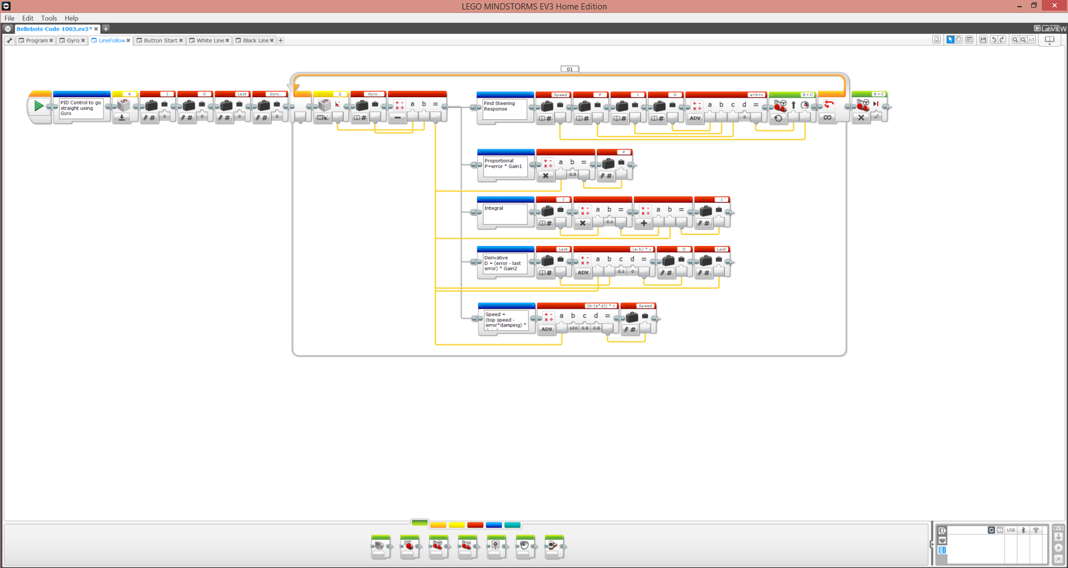
Can have different programs
Inside one project
Zooming, panning
Saving and
Commenting
Firmware update
Is under tools
Project properties
Is via the wrench
Bluetooth connection,
Port View (Sensor and
Motor values)
Shortcuts for running
Your program on the
robot
Command Blocks
Are down here

Slide 40
Getting Going on the Robot Game Exploring the Programming Environment
Set up Bluetooth!!
The key to programming is rapid iteration
Connecting and reconnecting cables will slow you down too much
To do this:
Turn on Bluetooth on the controller.
Then go to your computer’s Bluetooth set-up, and pair the computer to the controller.
Then go to the programming SW and select the “available bricks” tab in the bottom right corner.
Select your brick, and check the Bluetooth box.
Once BT is established, you can leave the robot on the table and send programs to it by using the 3 buttons in the very bottom right

Slide 41
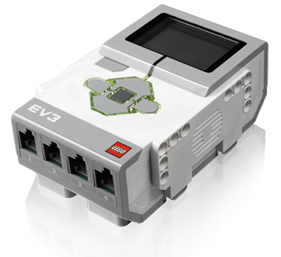
Getting Going on the Robot Game Understanding the Lego Controller
Screen
Numbered ports (sensors)
Lettered ports (motors)
Charging port (rechargeable battery)
On/Off button

Slide 42
Getting Going on the Robot Game Building a Starter Robot
Before your team tries to build a sophisticated robot designed for this year’s game, it’s a good idea to build a simple robot
two wheels + ball bearing
Two large motors (wired to ports B&C)
Lots of simple robot designs on line if you want help.
Example: https://www.youtube.com/watch?v=HsLqiShzP0k
Worry about creating a robot for the missions AFTER you understand what you can do with the robot and how to program it.

Slide 43
Getting Going on the Robot Game Key Design Elements for the Starter Robot
Easy removal of the controller to replace batteries
Access to the charging port
Access to the wiring ports

Slide 44
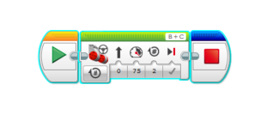
Getting Going on the Robot Game Exploring the Programming Environment
First program:
To run this program on the robot, you can do one of 3 things when connected to BT:
Push the green triangle in the first block.
Push the small “play” triangle in the circle at the bottom right of the screen
To run a portion of the program, highlight the brick in the middle, and click the small “Play” triangle in parentheses at the bottom right of the screen.
To stop the program mid-run, either
Press the upper left button on the brick; or
Press the small square button in the bottom right of the screen (that took the place of the “play” triangle)
Start
Drive Forward
straight at 75%
power for 2 motor
revolutions, using
motors B&C, and
then stop the
motors
End

Slide 45
Session 5
Robot Programming

Slide 46
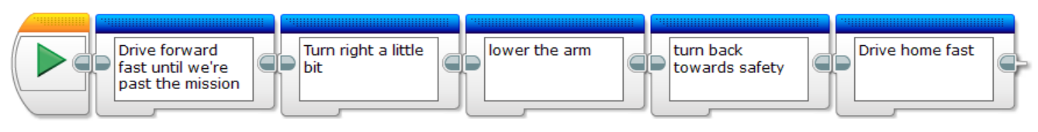
Robot Programming Coding in Comments First
Teaching the kids to code starts with teaching them to think in sequential steps
One approach is to have the kids lay out the steps they want the robot to do in words before they write code. They don’t have to know the distances or speeds – just say what they want the robot to do.
An easy way to do this is to use “Comment Blocks” (blue blocks). For example:
These can then be filled in with command blocks:

Slide 47
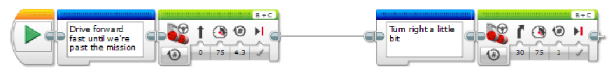
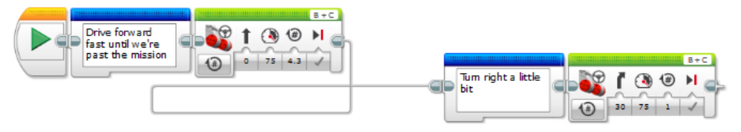
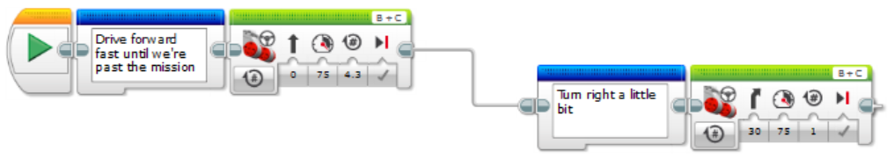
Robot Programming General Concepts
Connecting Bricks
Bricks dropped next to each other generally click together
Alternatively, you can click on the connector on the right of a brick and drag a wire connection to the left side of the subsequent brick. This lets you put bricks in rows, so you can see more on the screen at one time.
Managing Brick Connections
When bricks are connected, clicking on (1) removes the wire connection and snap-connects the bricks directly.
Clicking on the right side of the wire (2) disconnects the wire.
Clicking on (3) re-routes the wire to clean up the connection visually.
1 2 3

Slide 48
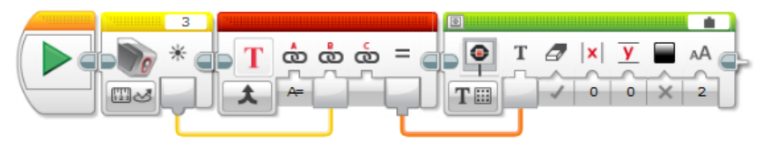
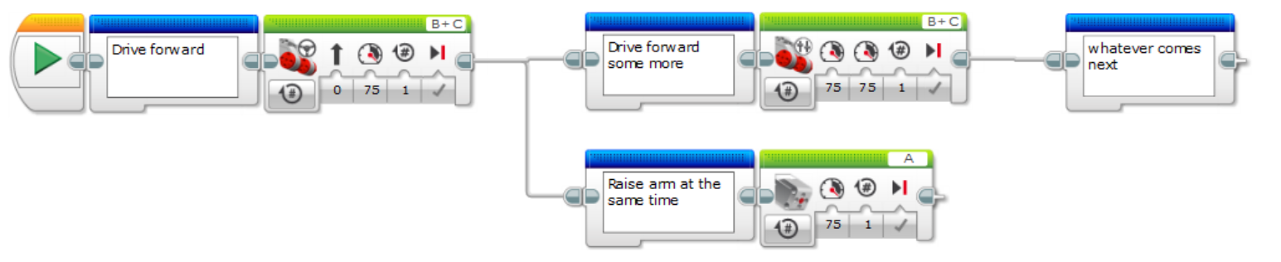
Robot Programming General Concepts
Wires
Information can be passed between bricks using wires. For example, the blocks to the right read a light sensor value and pass that value to a text concatenator, which passes it to a command to write it on the screen.
Multi-threading
You can run multiple blocks concurrently, for example to save time. To do this, create a branch

Slide 49

Robot Programming Basic Types of Commands: Action Blocks
1 2 3 4 5 6 7
Medium Motor: Control (a) which port it is plugged into, (b) how it should be turned on or off, (c) how much power to give the motor, (d) how many revolutions, degrees, or seconds it should run, and whether it should stop hard when it’s done, or glide to a stop. Use negative numbers to drive the motors in the opposite direction.
Large Motor: Control (a) which port it is plugged into, (b) how it should be turned on or off, (c) how much power to give the motor, (d) how many revolutions, degrees, or seconds it should run, and whether it should stop hard when it’s done, or glide to a stop.
Move Steering: Controls two wheels together to steer. Control (a) which port each motor is plugged into, (b) how they should be turned on or off, (c) how much the wheels should turn left or right, (d) how much power to give the motors, (d) how many revolutions, degrees, or seconds they should run, and whether they should stop hard when they’re done, or glide to a stop.
Move Tank: Controls each wheel independently to steer. Control (a) which port each motor is plugged into, (b) how they should be turned on or off, (c) how much the wheels should turn left or right, (d) how much power to give the motors, (d) how many revolutions, degrees, or seconds they should run, and whether they should stop hard when they’re done, or glide to a stop.
Display: Controls what is on the display. Can display text, shapes, image files, or reset the screen.
Sound: Controls sound output. Can play tones for different lengths of time, at different frequencies and volumes, or can play audio files.
Brick Status Light: Controls the status light on the brick. Can select the color shown.

Slide 50

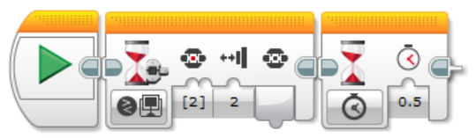
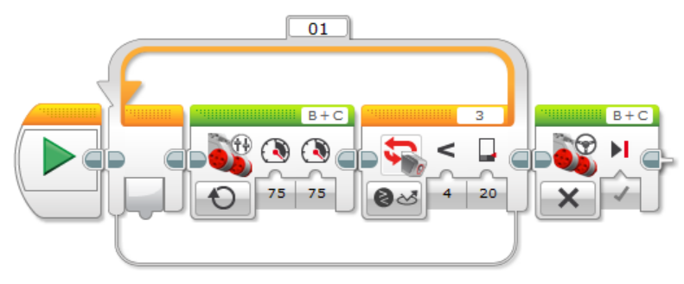
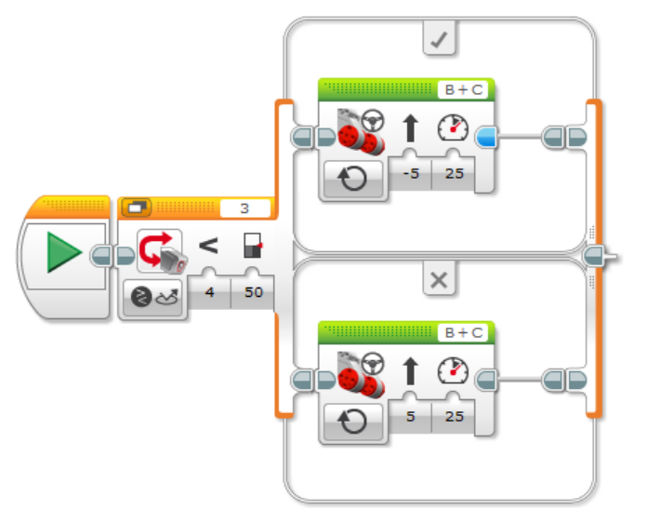
Robot Programming Basic Types of Commands: Flow Control Blocks
1 2 3 4 5
Start. This tells the code where to start the program. Clicking on this green arrow also sends the program to the brick and runs the program (when the robot is connected to the computer via cable or Bluetooth)
Wait. This block creates a pause. It can pause for an amount of time, or it can wait until one of the sensors registers a value. Tip: at the start of a program, add a “wait: middle brick button bumped” and “wait: 0.5s”. These allow you to launch the program from the computer via Bluetooth, but the robot won’t move until you press the middle button. In the competition, you can launch the program, and wait for the “Go!” to press the middle button, which is faster. The second wait lets the kids take their finger off the button before the robot moves.
Loop. Whatever brick sequence you put inside the loop will keep cycling until the condition on the right side is met. For example, the sequence to the right keeps the motors on until the light sensor reads less than 20 (as it might if it were looking for a black line).
Switch. This allows you to pick one of several code paths based on a sensed value. For example, the code to the right reads the light sensor and steers left if reading is >50 (more white) and right if the reading is <50 (more black), as in the simplest implementation of line following.
Loop Interrupt. This allows you to force an exit to a loop.

Slide 51

Robot Programming Basic Types of Commands: Sensor Blocks
1 2 3 4 5 6
Sensors are generally used to collect state data and to fee the data to some other decision making part of the code.
Brick Buttons. Can read whether a button is being pressed (or bumped, or released), and which button.
Color Sensor. Can read color, reflected light intensity, or calibrate (we’ll talk about calibration later). Can also compare the sensed value and output a true/false logic operator.
Infrared Sensor. Can measure or compare the distance to an object. Other features not used in FLL can also be selected.
Motor Rotation. Can read or compare the number of revolutions or power on a motor, and can reset the revolutions counter.
Timer. Can measure, compare or reset the value of a timer.
Touch Sensor. Can measure or compare the state of the touch sensor.
Other Sensors. If you want to use other sensors (eg, Gyro, Ultrasonic Distance Sensor), you can download the drivers at http://www.lego.com/en-us/mindstorms/downloads, then import their blocks under the Tools menu

Slide 52
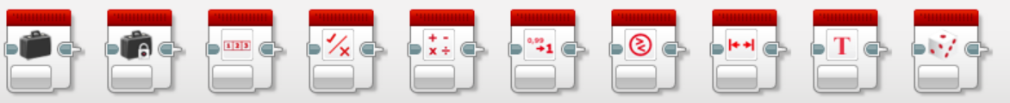
Robot Programming Basic Types of Commands: Data Operations Blocks
1 2 3 4 5 6 7 8 9 10
Variable. Allows you to assign a value to a variable, or to read a value from a variable. The first time you use a variable, you have to create it. You can remove variables in the project properties tab (small wrench in upper right).
Constant. Allows you to assign a value to a constant.
Array. Allows you to create a one-dimensional array, to input values, and to read values from an array address.
Logic. You can evaluate two true/false inputs via AND / OR / XOR / and NOT
Math. You can perform a number of math calculations on up to four input numbers. “Advanced” allows custom equations.
Round. Rounds numbers up, down, or truncates.
Compare. Compares two numbers and outputs true/false.
Range. Will tell you if an input number is within a upper and lower bounded range.
Text. Allows you to concatenate text and numbers from other inputs into a single string.
Random. Produces a random number within a bounded range

Slide 53

Robot Programming Basic Types of Commands: Advanced Blocks
1 2 3 4 5 6 7 8 9
With the exception of 9 & 10, these are not particularly useful in FLL
End. Terminates the program.
Comment. Allows you to annotate the program, in line.
Commenting note: You can also add comments to the program, not in line with the code, by using the “comment” button in the upper right of the screen (7th from the right).

Slide 54
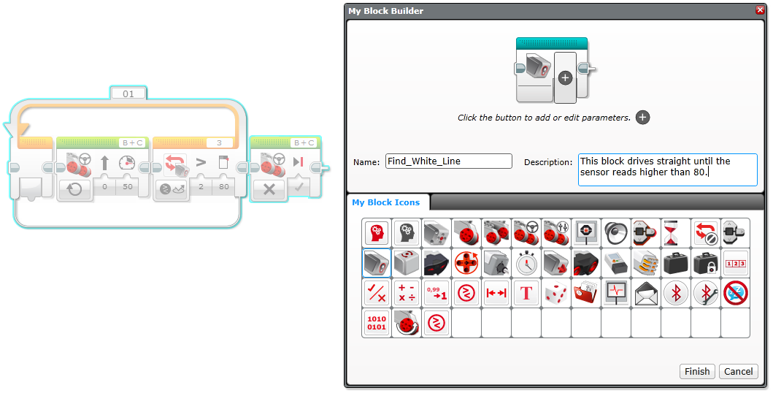
Robot Programming Basic Types of Commands: My Blocks
1 2 3 4 5 6 7 8 9
My Blocks allow you to create your own Command Blocks, consisting of other blocks.
To make a command block, create your block sequence, highlight the blocks, and go to the Tools menu → My Block Builder. Give the block a name and a description, and pick a block icon.
Note: Once the MyBlock is created, you cannot edit it. You can delete it under the project properties button (small wrench).
Example: Say we want to create a “Find White Line” command. We could create the MyBlock below.
Then, every time we want to find a white line, we just have to use a single light blue block.

Slide 55
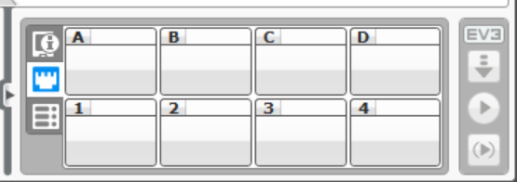
Robot Programming Developing a Sequence of Steps: Tips
When using Bluetooth, you can leave the robot on the table and execute one step of a program at a time to make sure it’s working as you expect. To do this:
Select the block(s) you want to run (they will be highlighted in blue)
Click on the run button in parentheses at the lower right of the screen
Use blue masking tape on the playing field mat to mark where the robot ends or starts, so you can see how reproducible the positioning is.

Slide 56
Robot Programming Communicating with the Robot: Port View
The port view (the middle tab on the box in the bottom right corner) shows the values of sensors and motors.
Reading these values helps you to troubleshoot code as it is executing

Slide 57
Robot Programming Revision Control
Many teams will have multiple kids programming in parallel. This can create situations where two versions of code branch off from eachother, leading to future problems.
Recommend developing a revision control method if your team expects this problem may arise. This could be as simple as saving each session’s work with a date and initials of the programmer, such as “Robot Code v2015-10-22gd.ev3”

Slide 58
Session 6
Completing Your First Robot Missions

Slide 59
Completing Your First Robot Missions Getting to Know Your Robot
Put your robot through the paces and write down the observations, such as:
How far does the robot travel per wheel revolution?
What “move tank” command will make the robot turn exactly 90o or 180o?
What “move steering command will make the robot turn 90o with a 2” radius on the inside wheel’s travel?
What do the sensors read in different conditions? On different areas of the playing field? In different ambient light?

Slide 60
Completing Your First Robot Missions Location and Orientation
The key to completing missions is to (a) know precisely where the robot is, (b) know precisely the robot’s orientation on the playing field, and then and only then, (c) have the right tool to complete the mission.
Some ways to orienteer:
Color sensor: line finding, line following, and line squaring
Touch sensor: wall squaring
Infrared / Ultrasonic Sensor: distance sensing
Gyroscopic Sensor: reading gyro values
Flat robot edge: wall squaring, wall following
The more missions you can string together in a single run, the more efficient you’ll use time, and the more points you can earn. Using frequent location checking enables this.

Slide 61
Completing Your First Robot Missions Sequencing the Steps
Before you start to code, think about what is required for each mission, and which missions go together. Consider: distance you have to travel, points to be earned, tools required on the robot, etc.
Map out each run your robot will do. You can change tools on the robot between runs if you want to. Some missions must be done before others in order to score both.
Consider which missions may not always work, and make sure the robot can recover to a known position and orientation before starting the next mission.

Slide 62
Session 7
The Project

Slide 63
The Project Scheduling Milestones

Slide 64
The Project The Right Level of Parental Involvement

Slide 65
Session 8
Moving to the Next Robot Level: Advanced Concepts (pt 1)

Slide 66
Advanced Concepts Orienteering and Navigation

Slide 67
Advanced Concepts Sensors

Slide 68
Advanced Concepts Line Finding and Following

Slide 69
Session 9
Moving to the Next Robot Level: Advanced Concepts (pt 2)

Slide 70
Advanced Concepts Robot Design Elements

Slide 71
Advanced Concepts Robot Design Components

Slide 72
Advanced Concepts Improving Repeatability

Slide 73
Session 10
Moving to the Next Robot Level: Advanced Concepts (pt 3)

Slide 74
Advanced Concepts Home Base

Slide 75
Advanced Concepts Environmental Conditions

Slide 76
Advanced Concepts Using the Lego Controller Display

Slide 77
Advanced Concepts Batteries

Slide 78
Advanced Concepts Time Management

Slide 79
Advanced Concepts Testing on Other Tables

Slide 80
Session 11
Revisiting Teaching Core Values

Slide 81
Teaching Core Values Ideas for Emphasizing Core Values on Your Team

Slide 82
Teaching Core Values Understanding the Role of Core Values in the Competition

Slide 83
Session 12
Preparing for the Competition

Slide 84
Preparing for the Competition Presentation Materials

Slide 85
Preparing for the Competition Rehearsal

Slide 86
Session 13
Competition Day

Slide 87
Competition Day What to Expect

Slide 88
Competition Day What to Bring

Slide 89
Competition Day Parents

Slide 90
Session 14
Wrapping Up the Season

Slide 91
Wrapping Up the Season Reviewing Judge Feedback

Slide 92
Wrapping Up the Season Inventorying, Replacing and Storing Lego Parts

Slide 93
Wrapping Up the Season Closing the Finances

Slide 94
Wrapping Up the Season Preparing for the Next Season

